Slide 1
Web scraping to gain company insights
British airwAys customer review insights
01-12-2022

Slide 2
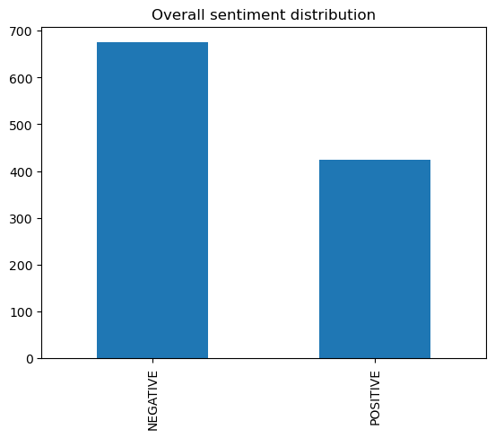
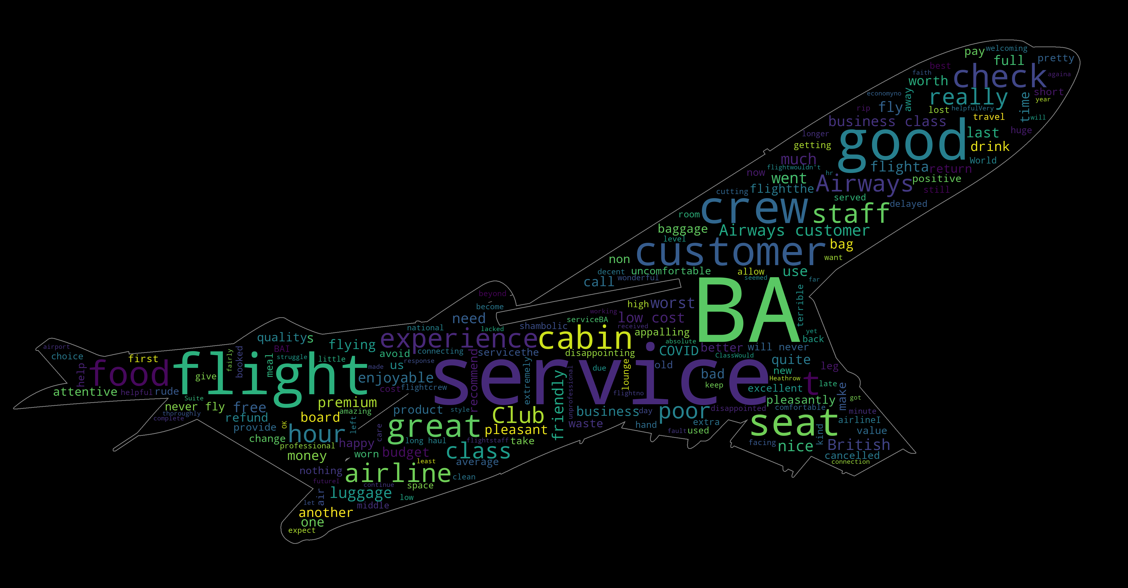
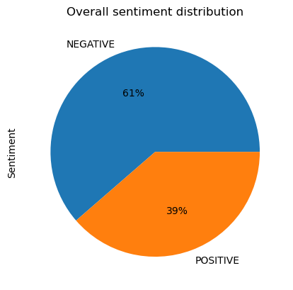
Insights
The first figure which is a WordCloud, illustrates the key terms extracted from the customer review.
The second figure is a pie chart which illustrates the percanted distribution of reviews according to Positive or Negative.
It can be derived from both the pie chart as well as the bar chart, that the Negative reviews are of a larger magnitude about British Airways than the Positive ones.

